Slide 1
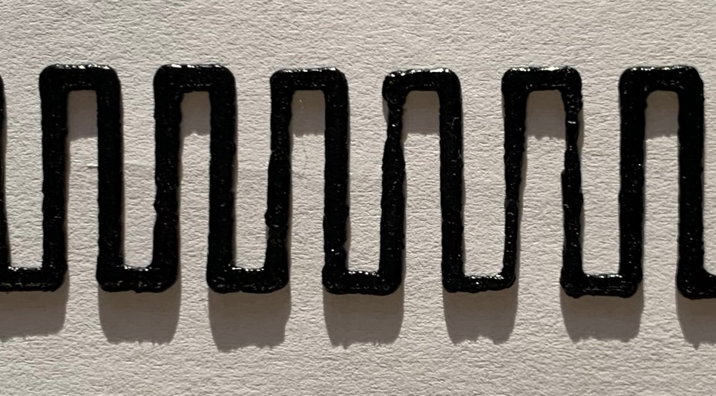
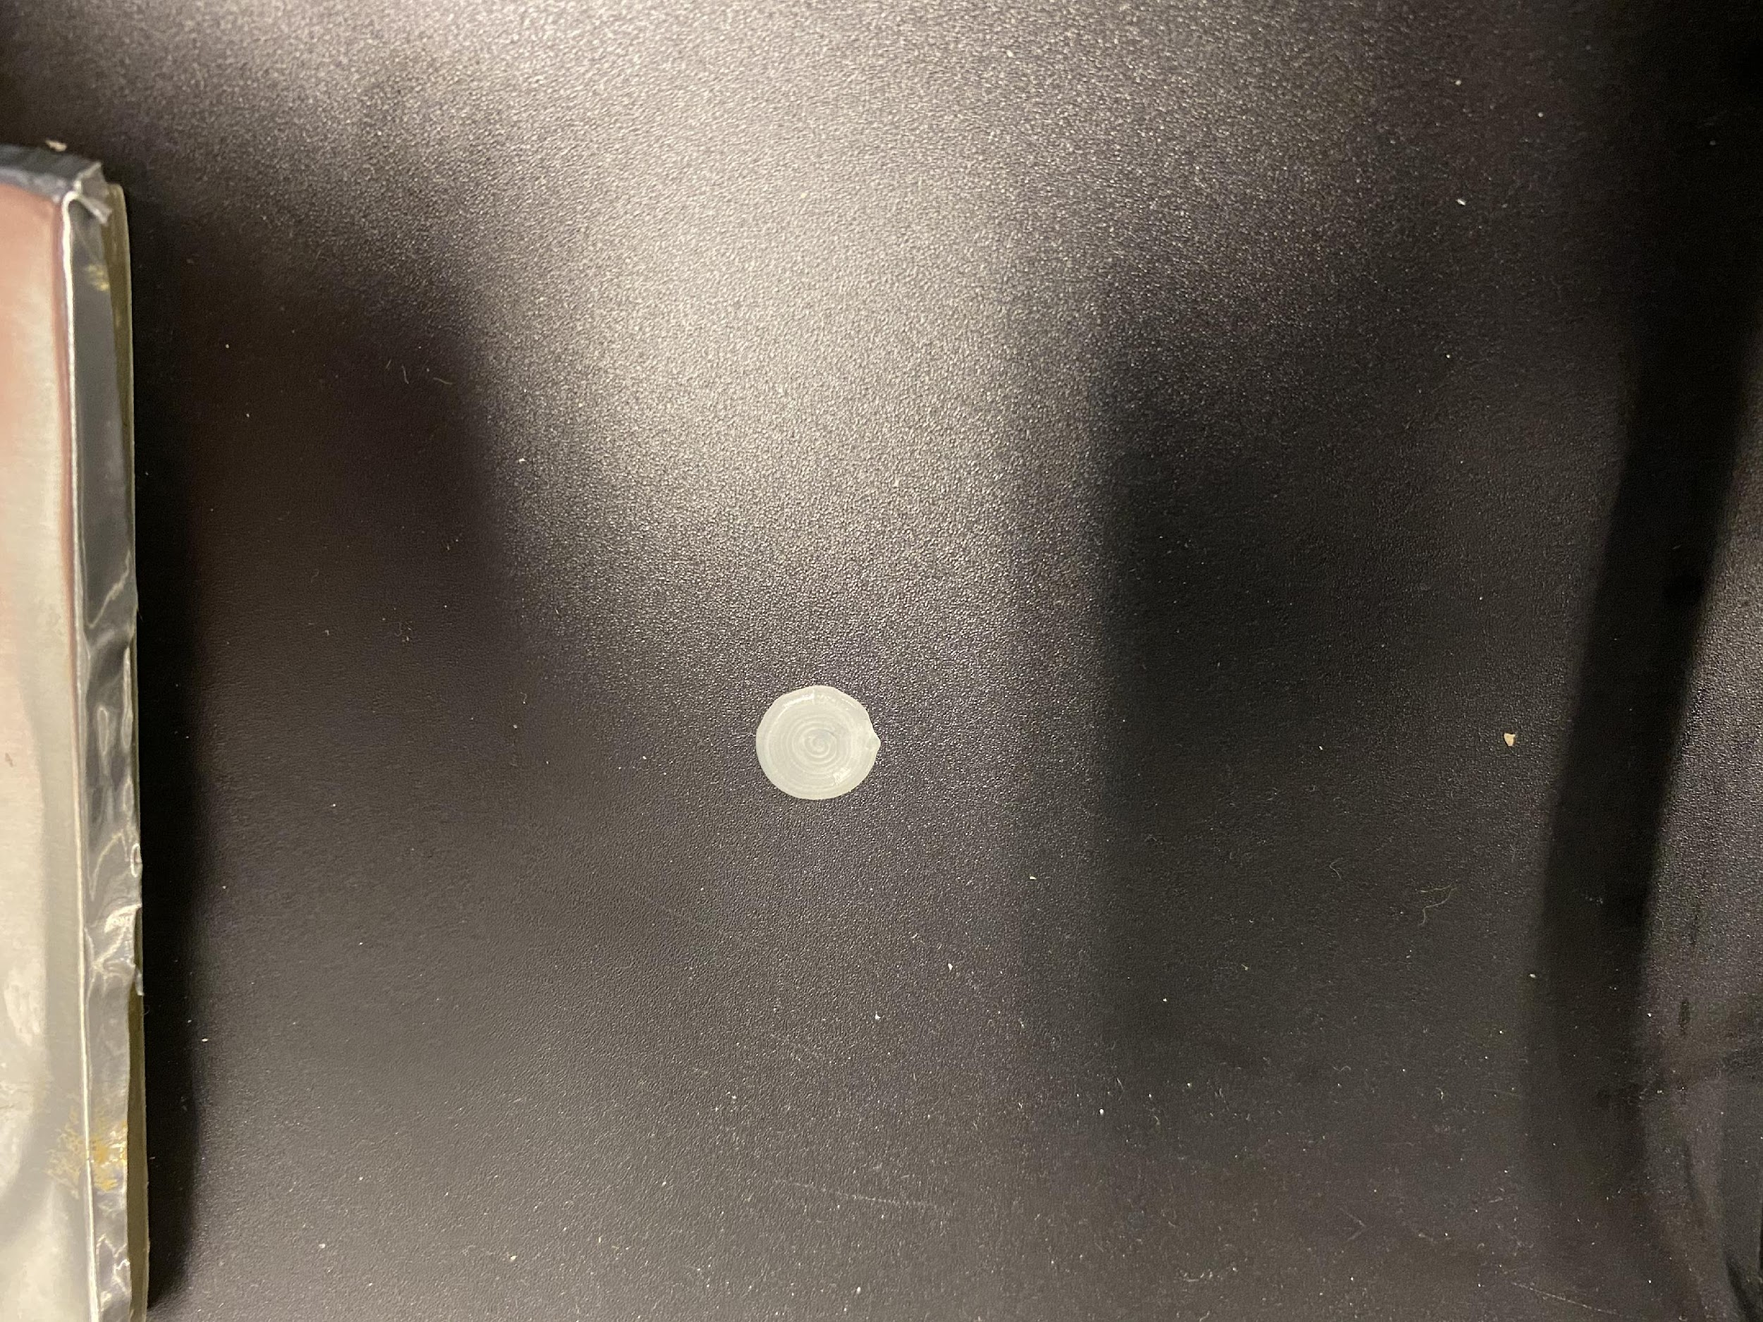
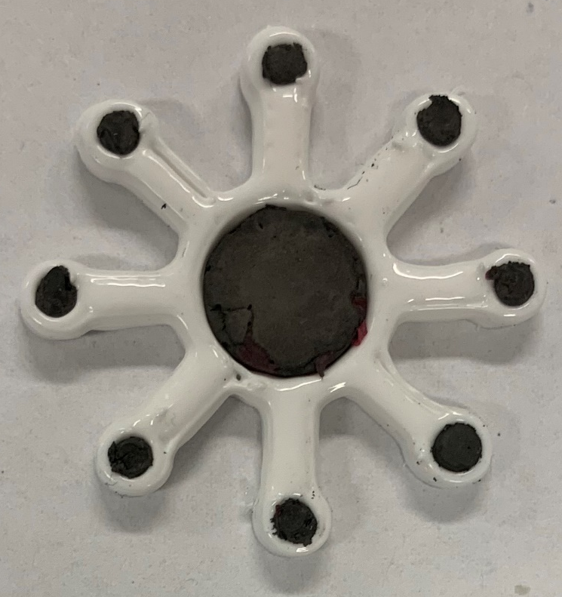
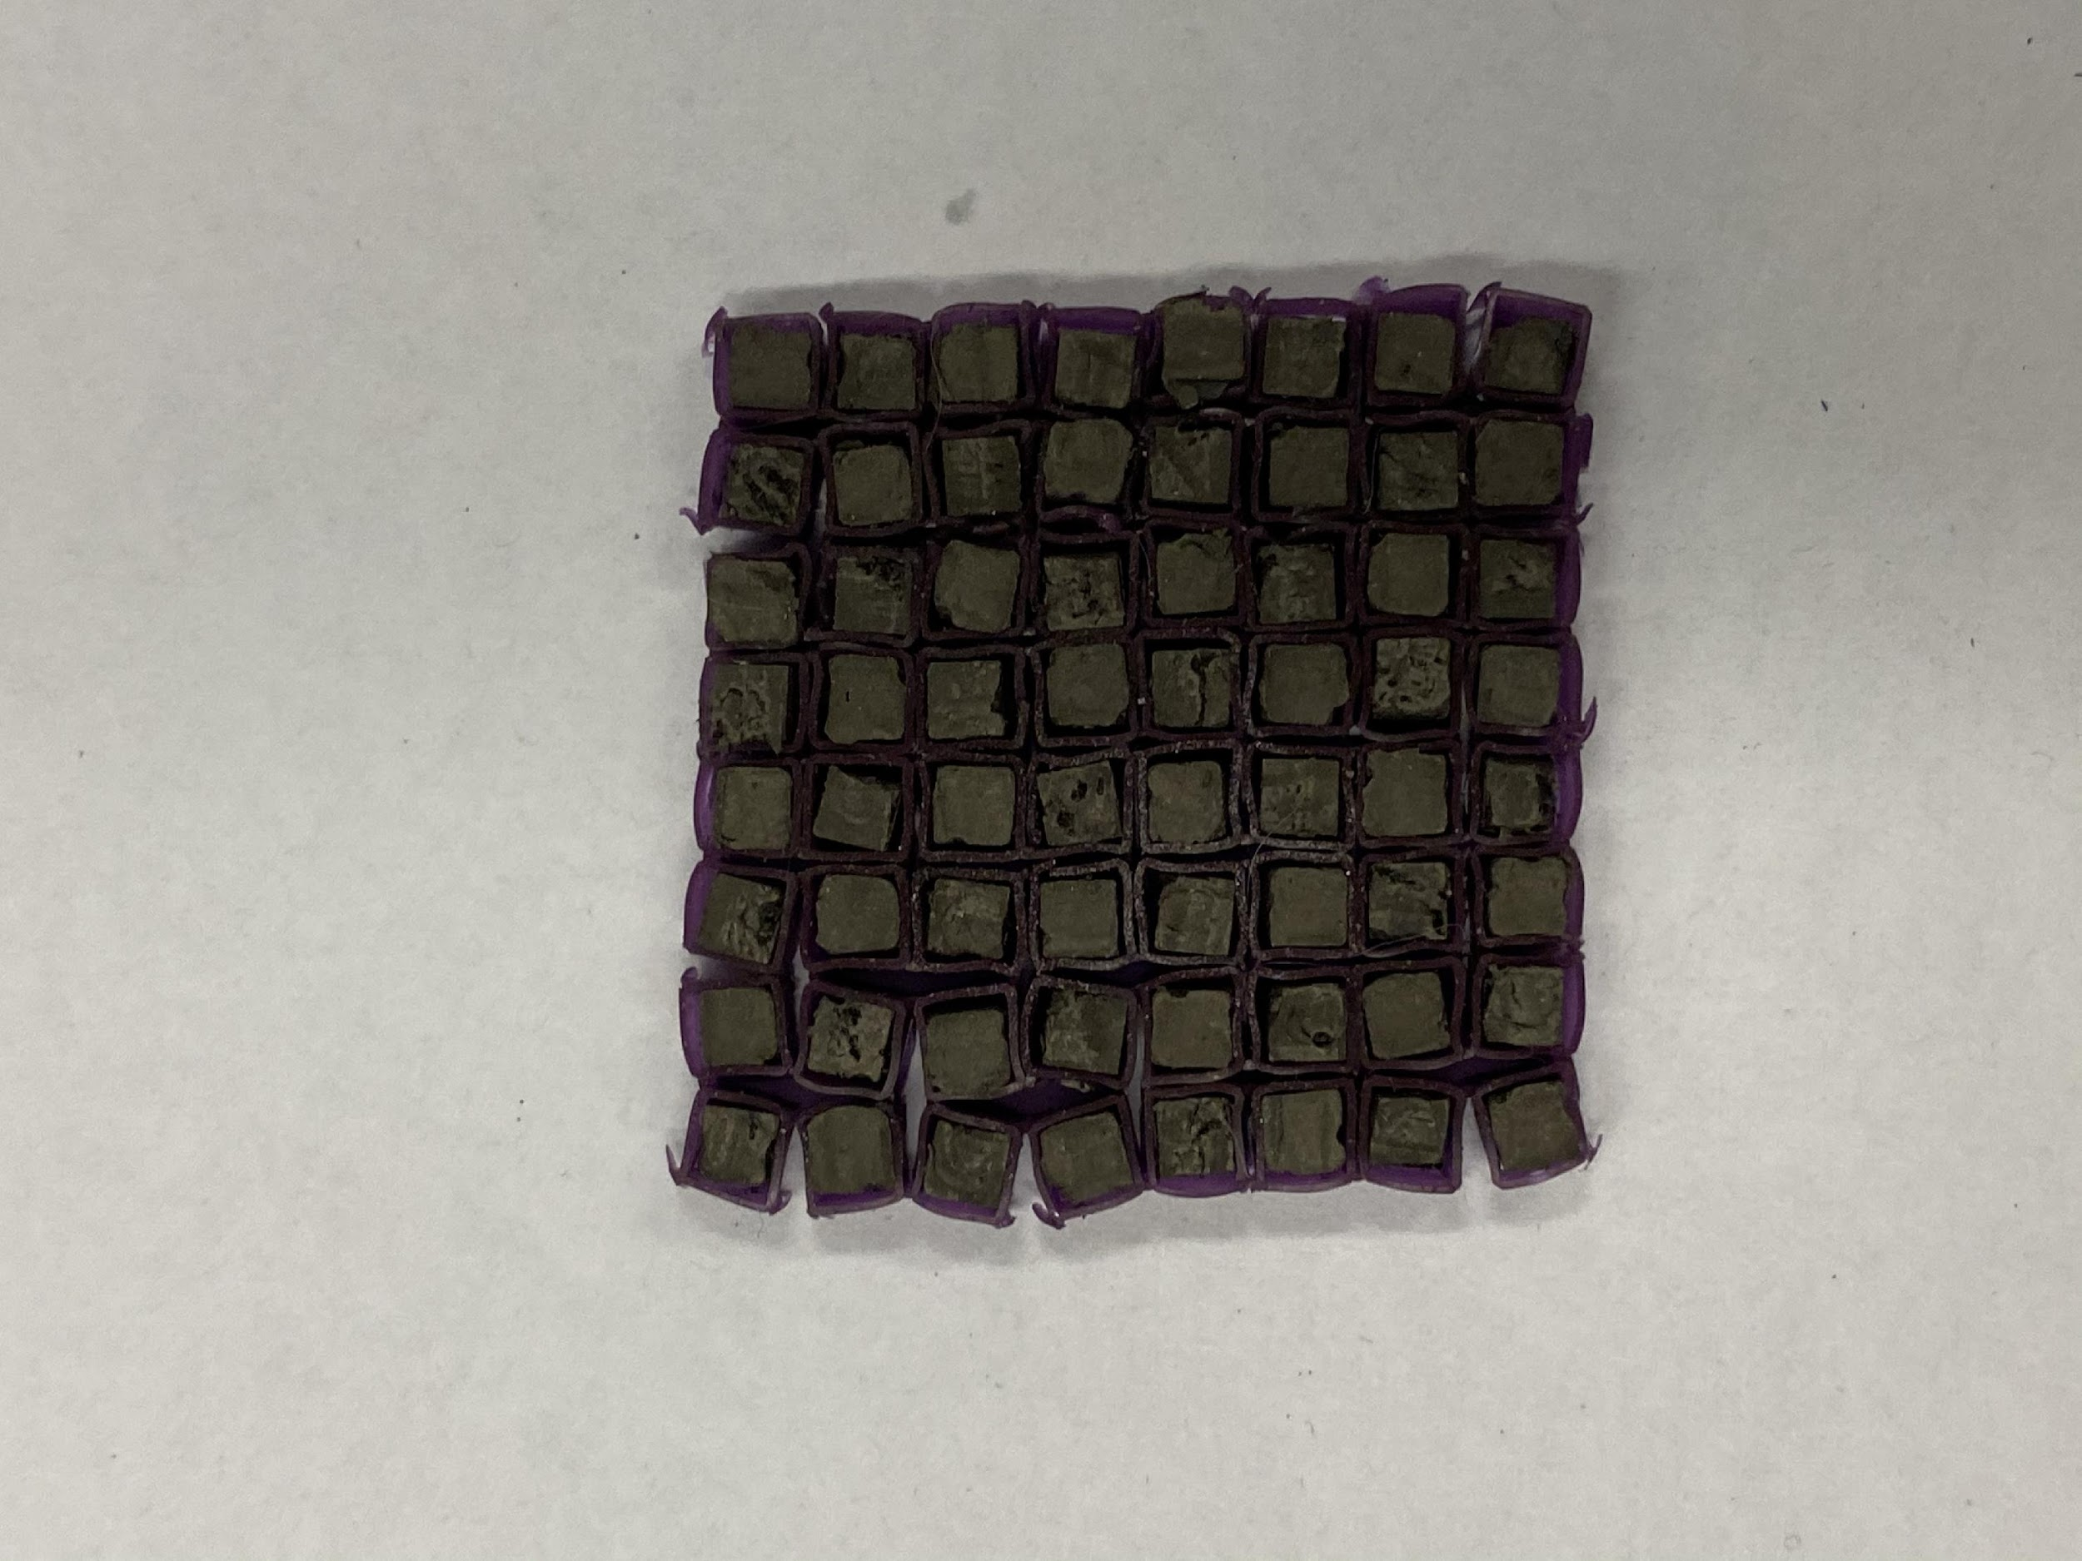
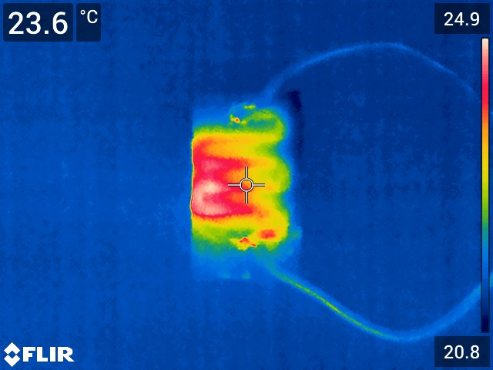
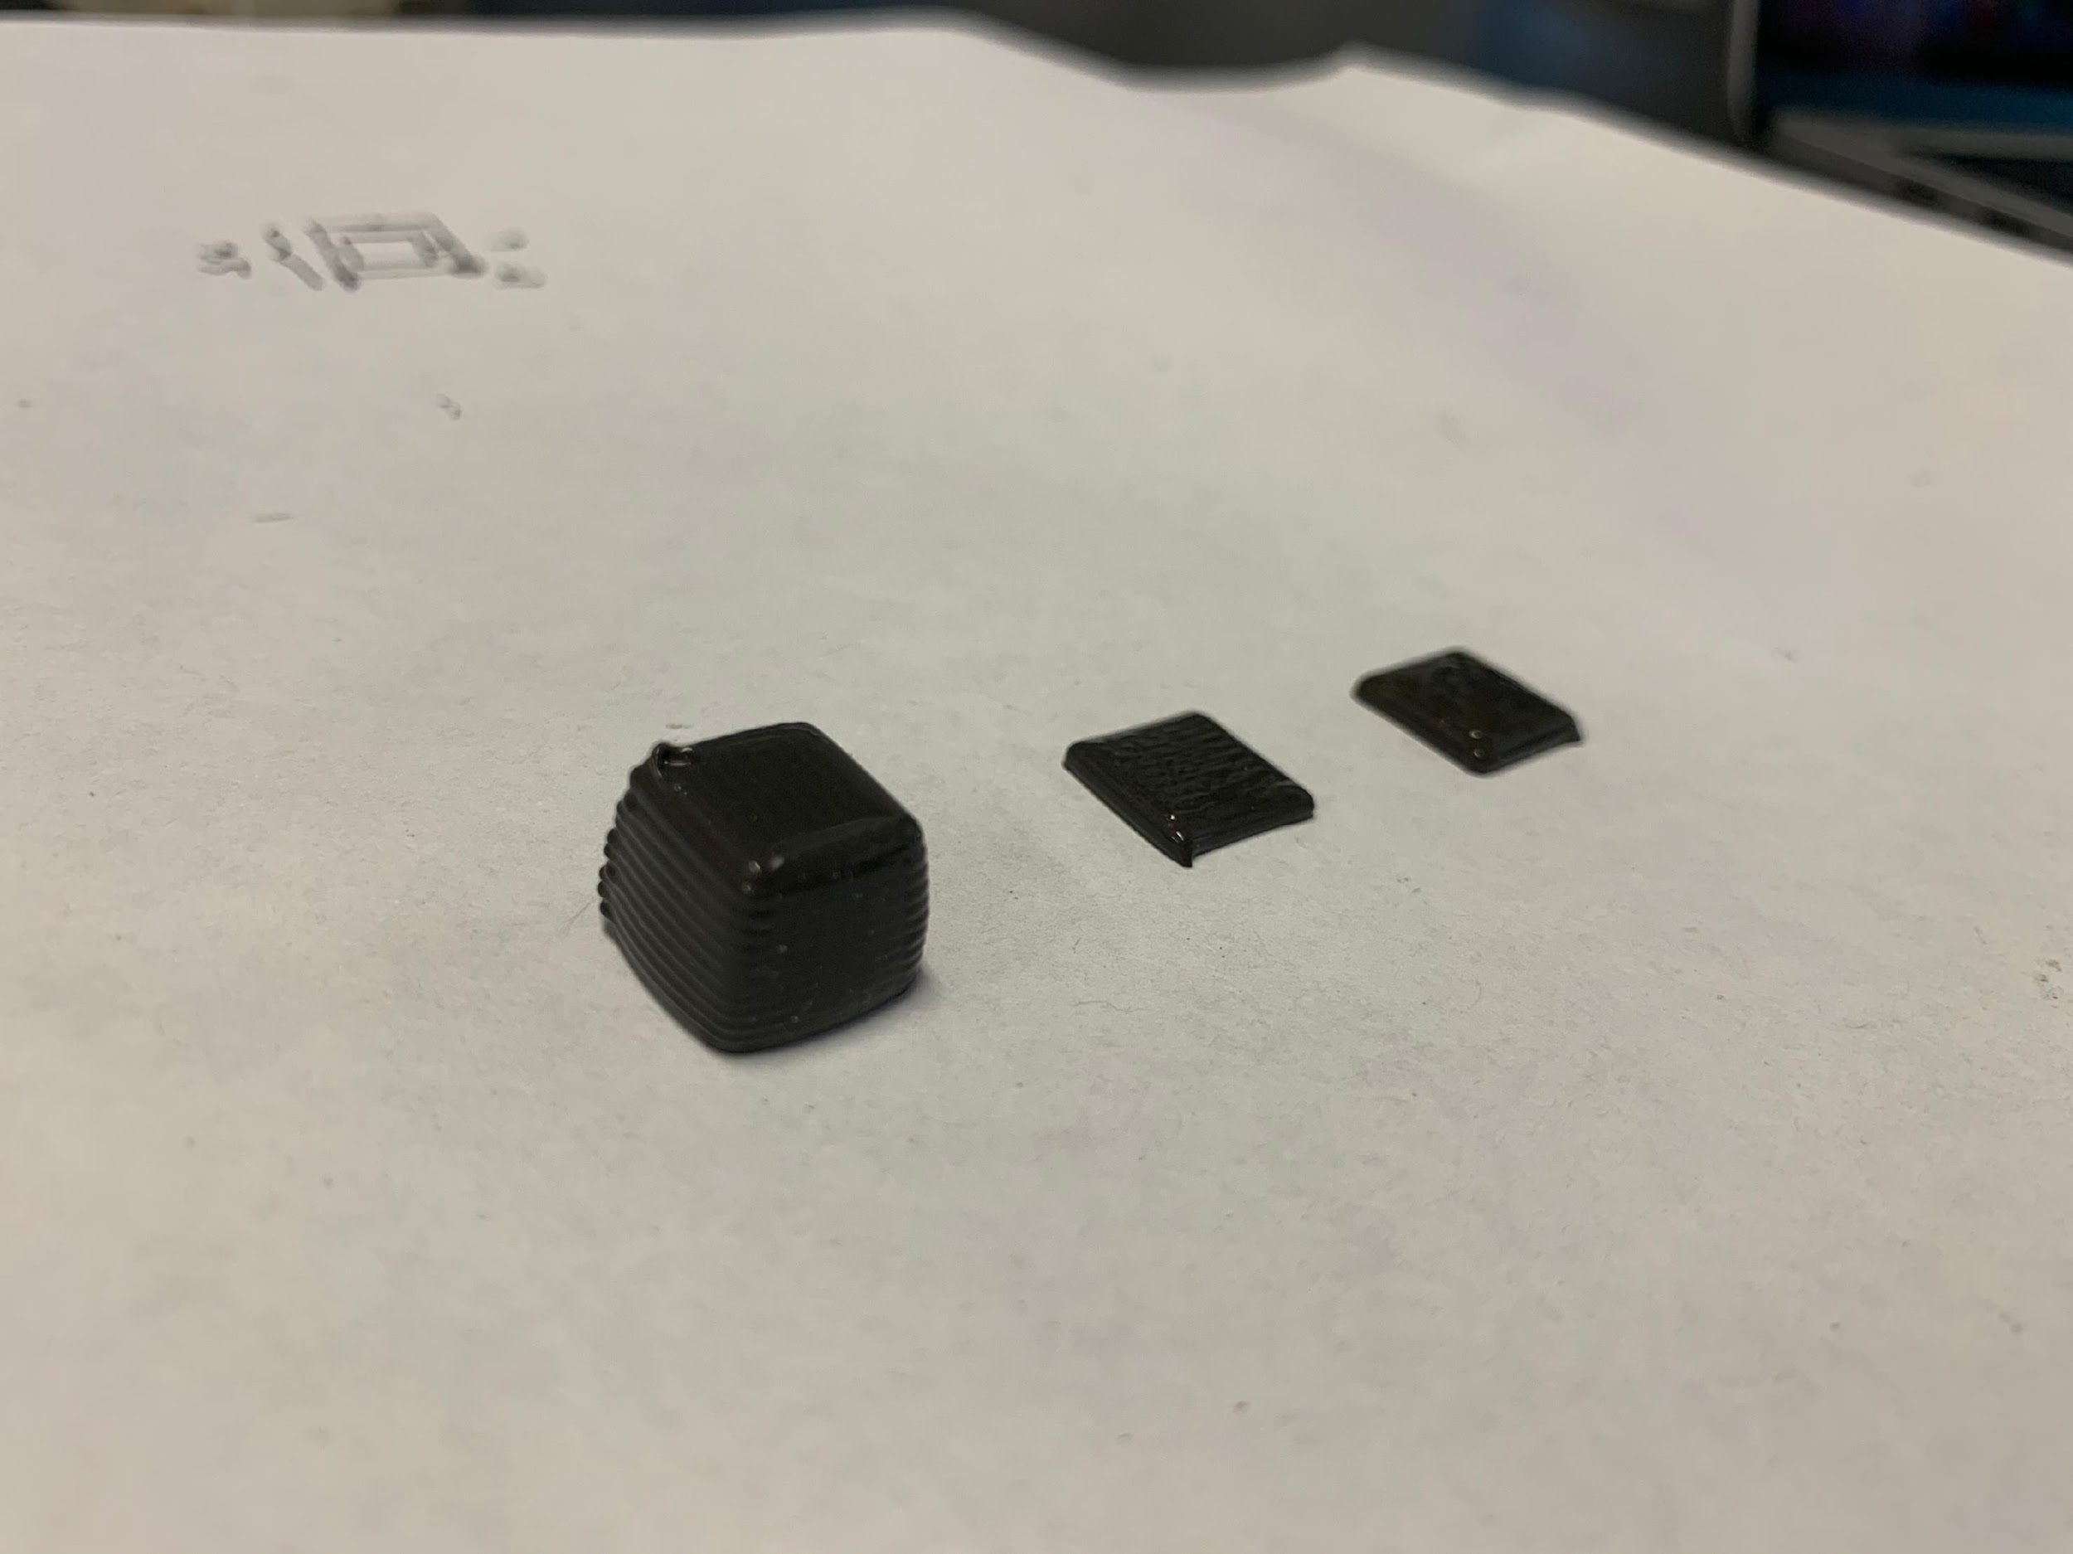
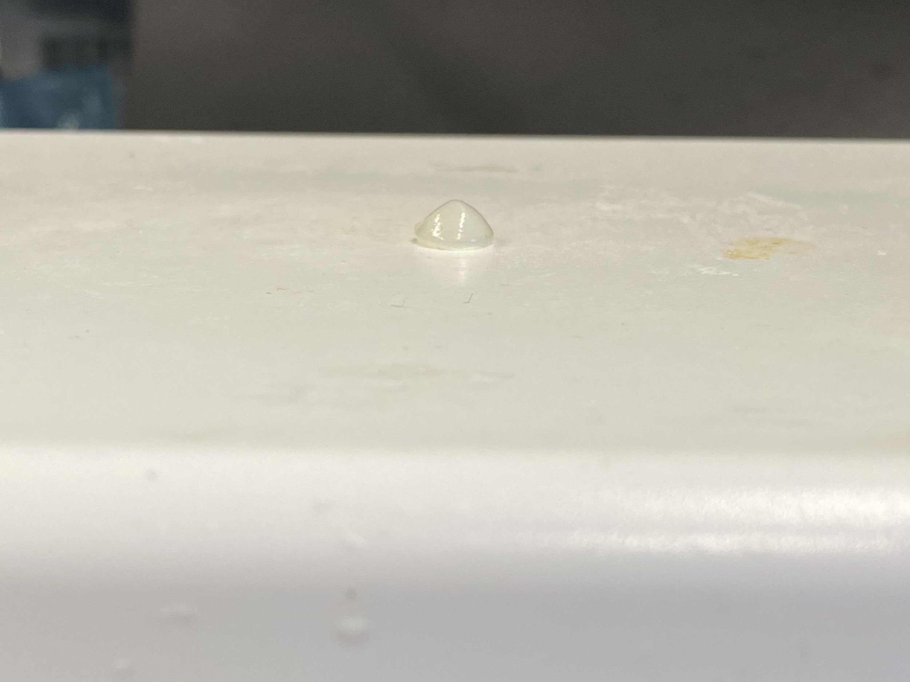
3D printing: new design space
Conductive silicone rubber
LCE
Magnetic silicone rubber
Materials: Fiber reinforced silicone rubbers, Conductive silicone rubbers, Magnetic silicone rubbers, LCEs, epoxy, hydrogels, liquid metal…
Techniques: bi-material printing, rotating nozzle…

Slide 2
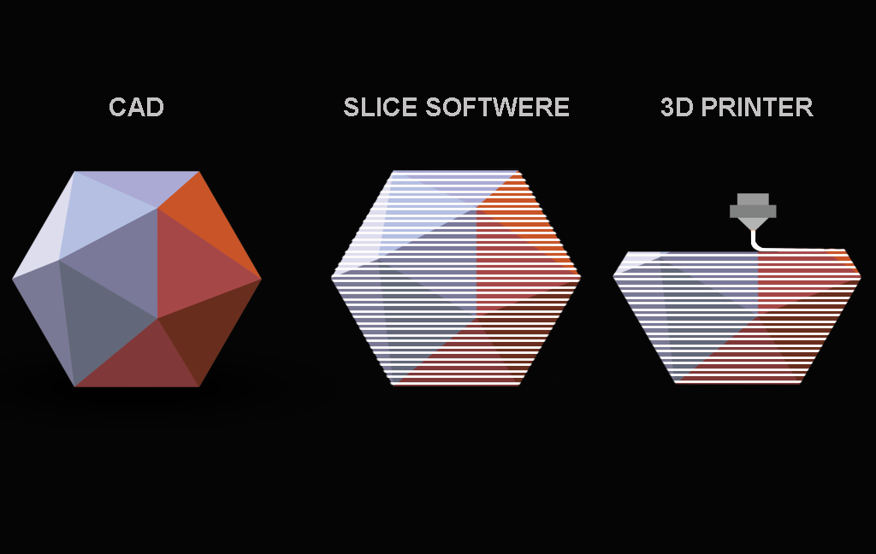
3D printing processes
“1D” processes:
Typically involves movement of a single point in a direction
Extrusion based (moving of a nozzle)
Fused Deposition modeling (FDM)
Direct Ink Writing (DIW)
Inkjet printing IJP (moving of an inkhead)
Vat photopolymerization (moving of a light source)
Stereolithography (SLA)
Two-photon lithography (TPP)
Powder bed fusion (moving of a heat source)
Selective laser melting (SLM)
Electron beam melting (EBM)
Multi-jet fusion (MJP)
Process largely driven by material:
FDM: glass transition of thermo-plastic
DIW: shear thinning behavior of complex fluids
SLA/TPP: photo reactivity of photo-polymers
PBF: melting and thermal fusion of powers (metals/polymers)
“2D” processes:
A single process can generate 2D structures
Digital light processing (DLP)
Multimaterial multinozzle (MM3D) 3D printing
“3D” processes:
A single process can generate 2D structures
1. Computed axial lithography (CAL)
For 1D processes:
Model
Slicer
Gcode
Machine

Slide 3
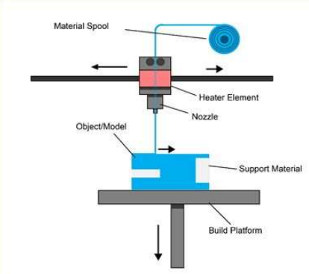
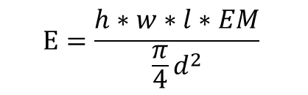
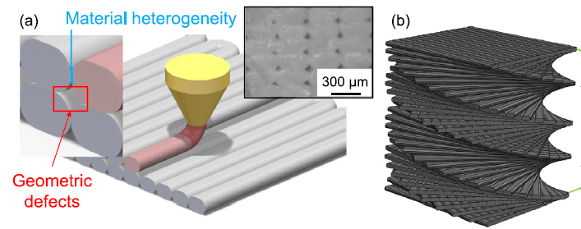
Fused deposition modelling (FDM)
Process parameters:
Nozzle temperature
Bed temperature
Printing speed (v)
Filament diameter (d)
Layer height (h)
Extrusion width (w)
Extrusion multiplier (EM)
G1 X19.753 Y1.650 E0.0253
G1 X0.248 Y1.650 E1.0947
G1 X0.248 Y2.100 E0.0253
G1 X19.753 Y2.100 E1.0947
G1 X19.753 Y2.550 E0.0253
G1 X0.248 Y2.550 E1.0947
G1 X0.248 Y3.000 E0.0253
G1 X19.753 Y3.000 E1.0947
G1 X19.753 Y3.450 E0.0253
G1 X0.248 Y3.450 E1.0947
G1 X0.248 Y3.900 E0.0253
G-code
Commonly used materials:
Poly-lactic acid (PLA)
Acrylonitrile butadiene styrene (ABS)
Polyethylene (PET)
Nylon

Slide 4
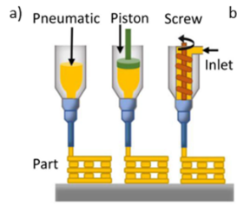
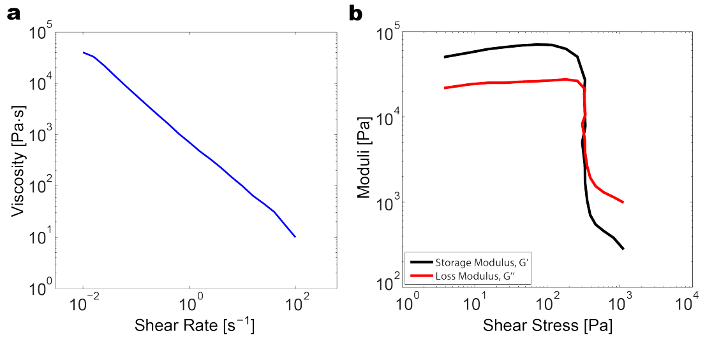
Direct Ink writing (DIW)
Process parameters:
Extrusion pressure
Printing speed
Nozzle diameter
Layer height
Shear-thinning behavior is key for direct ink writing
Active material 3D printing:
Liquid crystal elastomer
Composites
Magnetic soft composites

Slide 5
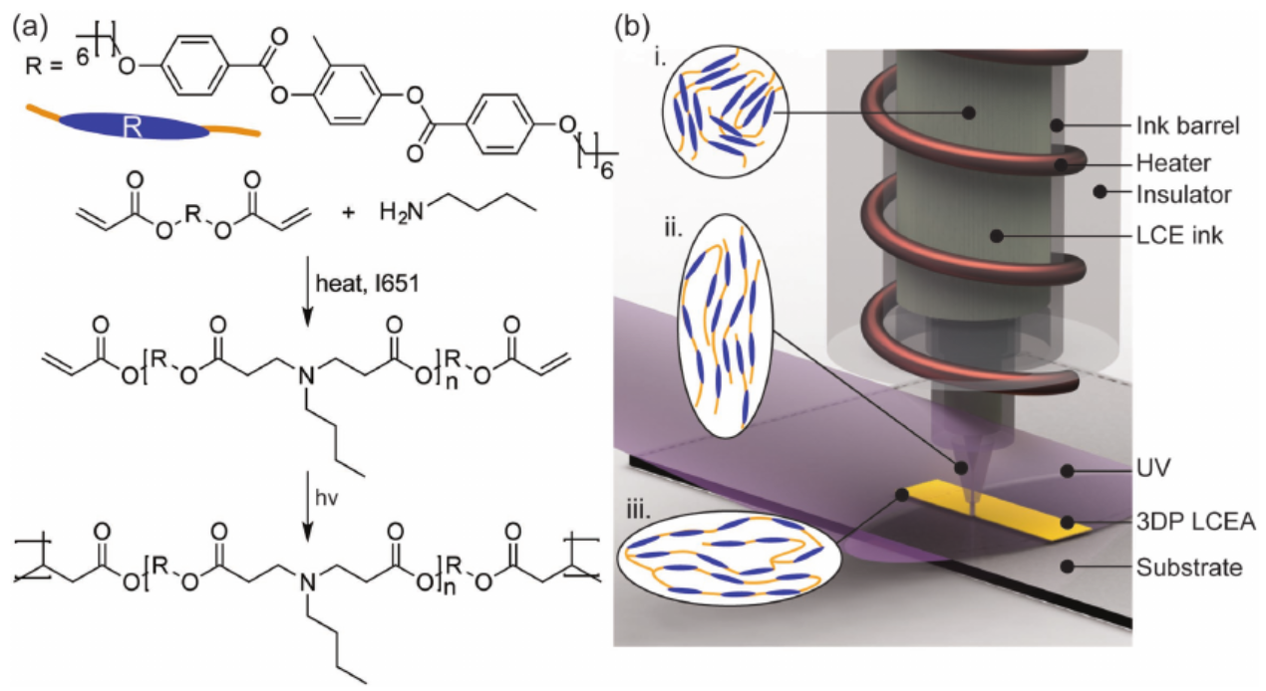
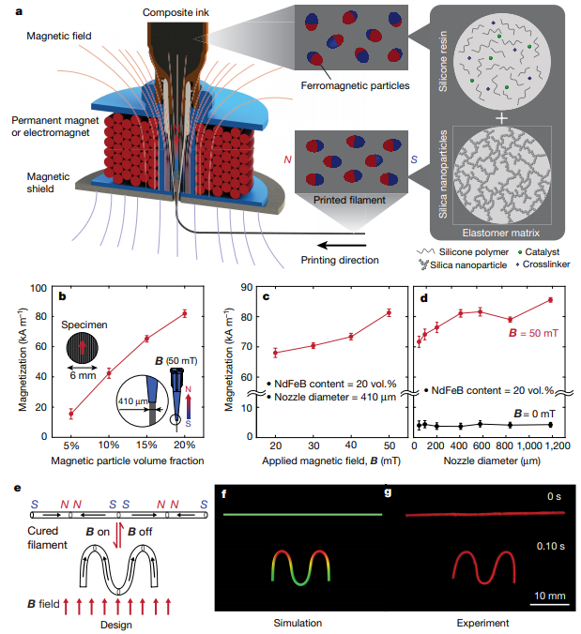
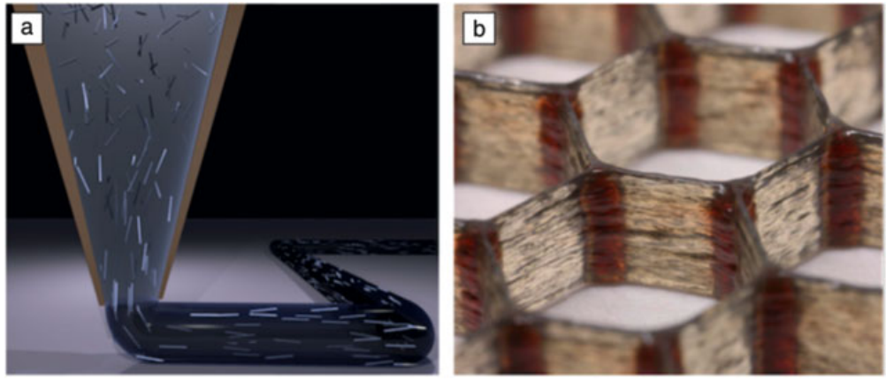
Direct Ink writing (DIW)

Slide 6
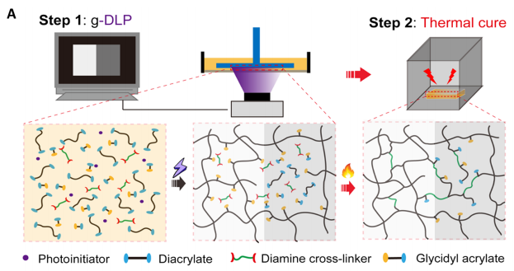
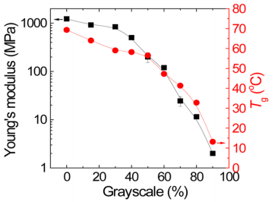
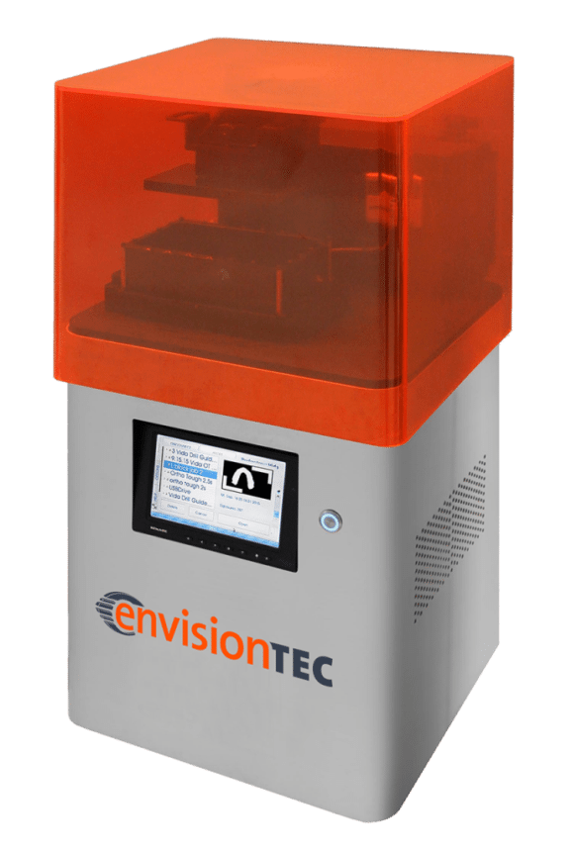
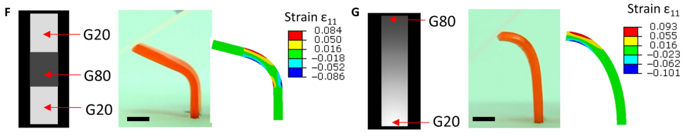
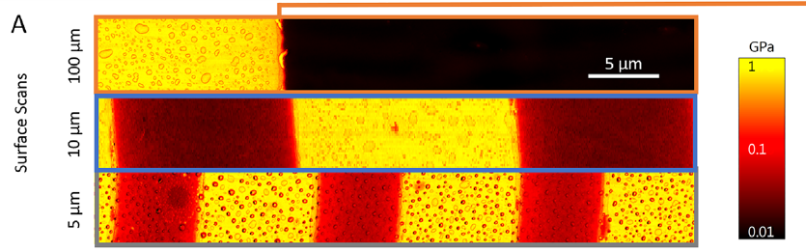

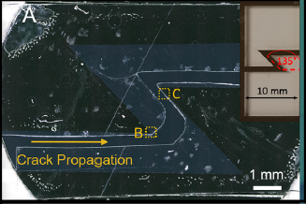
Digital light processing (DLP)
A job file includes following items:
Build list (exposure time per layer)
Data processing info (build process)
Job info (printer setup)
Exposure images (1920x1080 pixels)
Image properties:
8-bit depth black and white images
Highly accurate and allow overhang structures
Two-stage polymerization Thermal + Photon

Slide 7
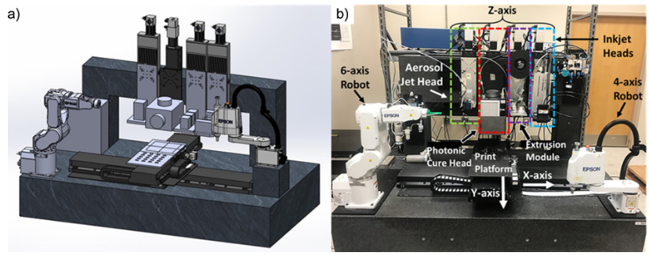
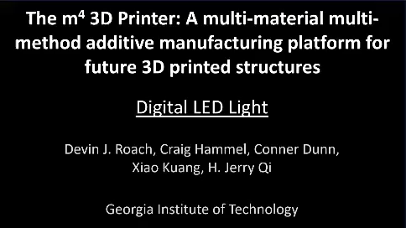
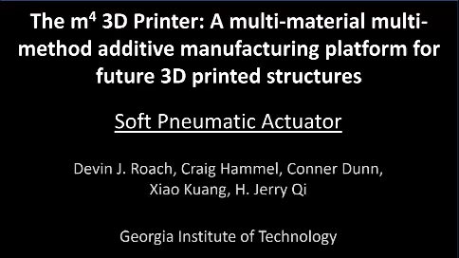
Multi-process 3D printer

Slide 8
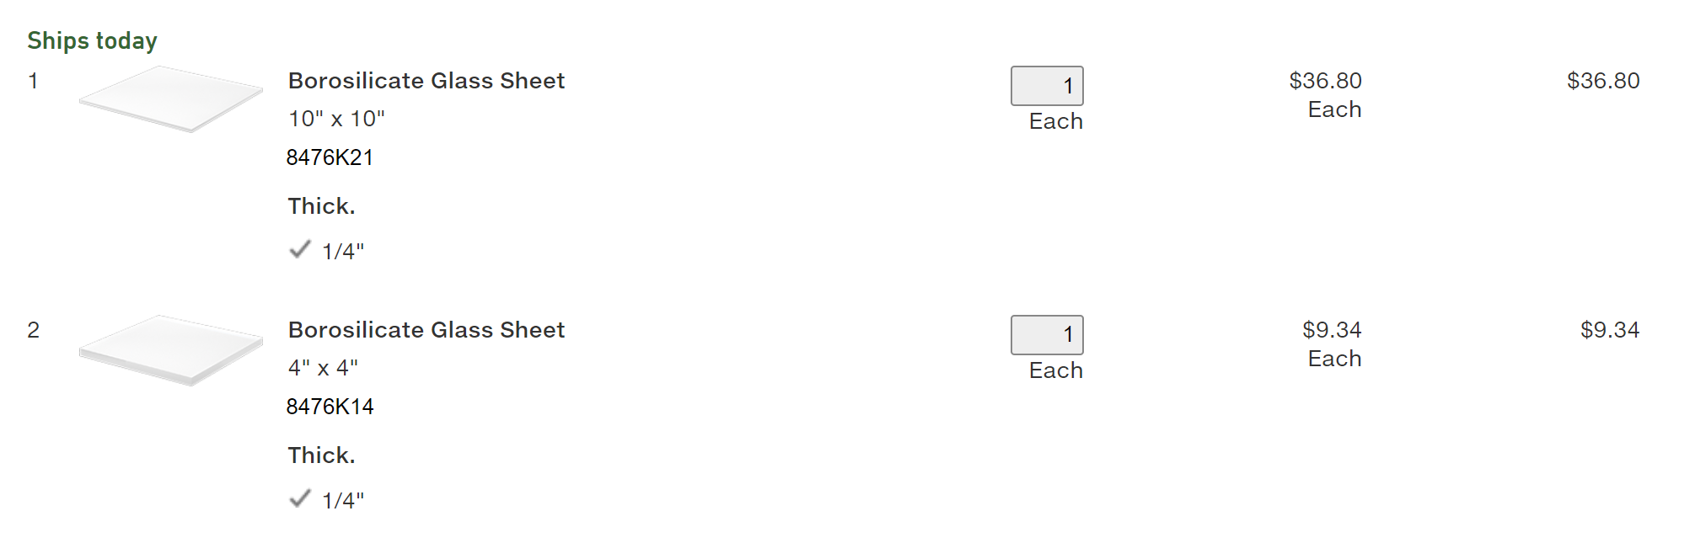
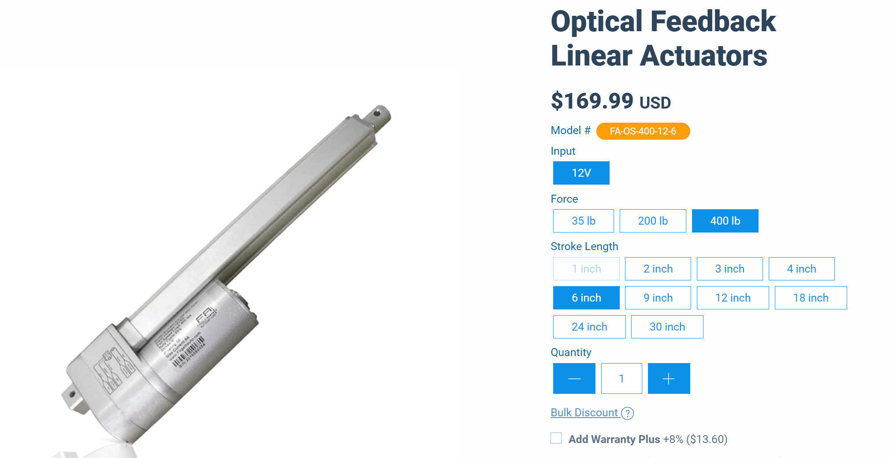
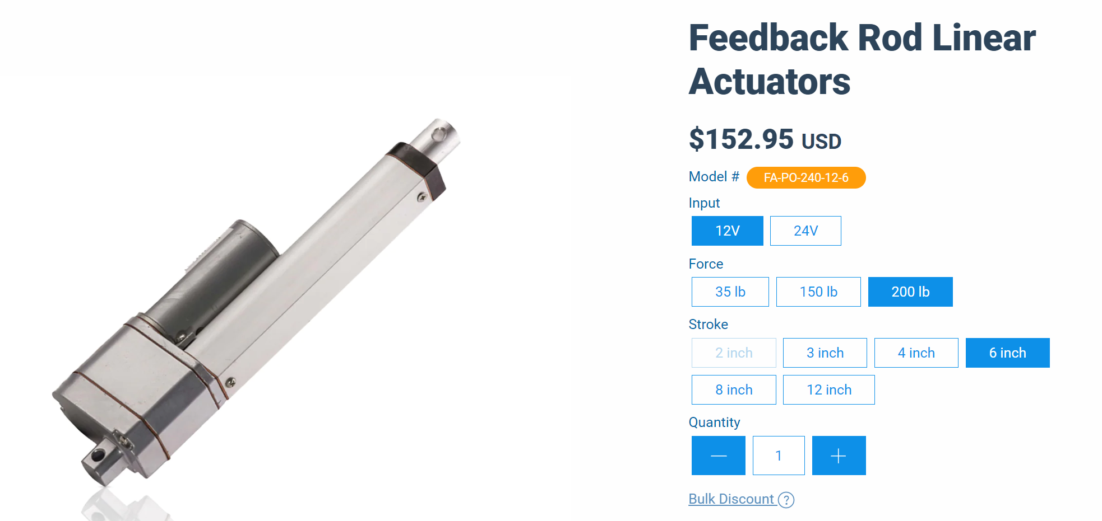
Notes:
https://www.firgelliauto.com/products/optical-sensor-actuators?variant=16326698565703

